Slide 1
AI Technology Trends Dashboard (2020–2025) Power BI Project Presentation
NAME: Harshita Bajaj
Course: Data Processing & Business Analytics
Tools: Power BI, Excel

Slide 2
Introduction
Artificial Intelligence is rapidly transforming industries worldwide.Organizations are adopting AI to improve efficiency and decision-making.This project presents an analysis of AI technology trends from 2020 to 2025 using Power BI.

Slide 3
Project Objective
To analyze the growth of AI technologies over the years.
To study industry-wise and country-wise AI adoption.
To identify in-demand AI skills and job market trends.

Slide 4
Dataset Overview
Dataset includes AI-related data from 2020 to 2025.
Key attributes: Industry, Country, Skill, Salary, Investment, Growth Rate.
Data is used for comparative and trend-based analysis.
Dataset Overview

Slide 5
Tools & Technologies Used
Power BI: Interactive dashboard creation and visualization.
Excel: Data cleaning and preprocessing.
DAX: Calculation of KPIs and measures.

Slide 6
Key Performance Indicators (KPIs)
Total number of AI startups.
Average salary of AI professionals.
Total investment in AI technologies.
Average growth rate across industries.

Slide 7
Industry-wise Analysis
AI adoption is analyzed across multiple industries.
Healthcare, Finance, IT, and Education show significant growth.
Visual comparison helps identify high-performing industries.

Slide 8
Skill Popularity Analysis
Analysis of popular AI skills such as Machine Learning, Data Science, NLP, and Cloud Computing.
Skill popularity scores indicate current market demand.
Helps students and professionals understand required skills.

Slide 9
Country-wise Investment Analysis
Global map visualization shows AI investment by country.
USA, India, and European countries lead in AI investments.
Country-wise analysis highlights regional AI development.
Country-wise Investment Analysis

Slide 10
Conclusion
AI technology is growing consistently across industries and regions.
Investment and salary trends indicate strong demand for AI professionals.
BI effectively converts complex data into meaningful insights.

Slide 11
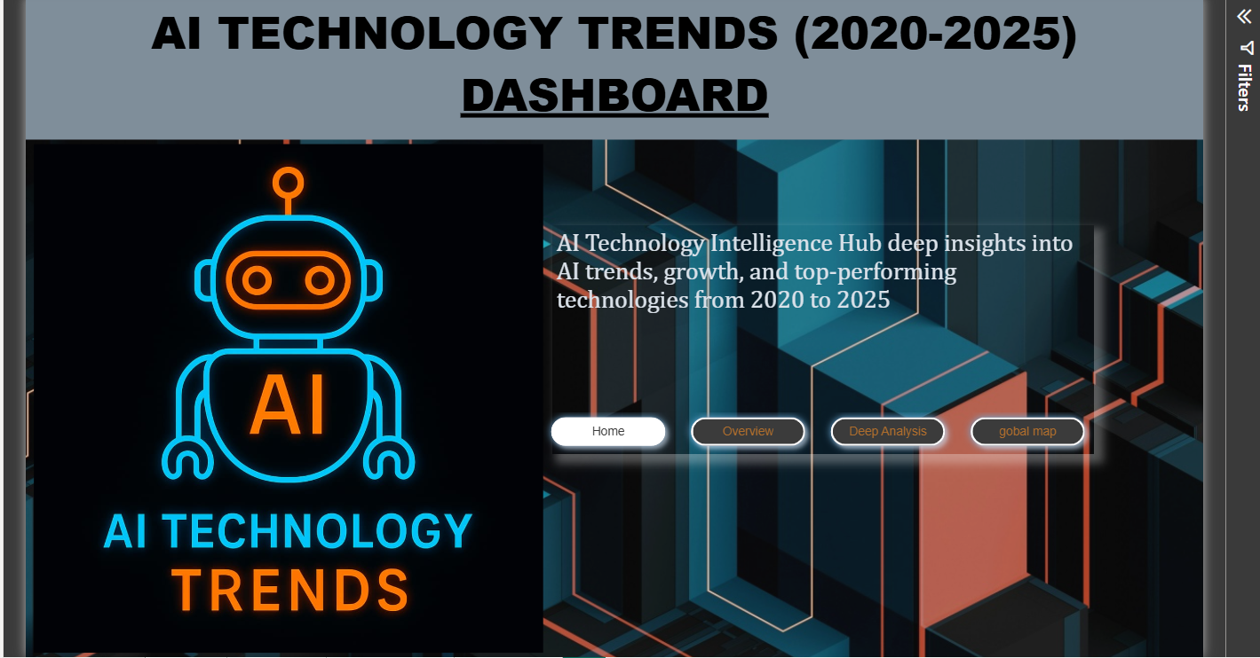
Notes:
Home

Slide 12
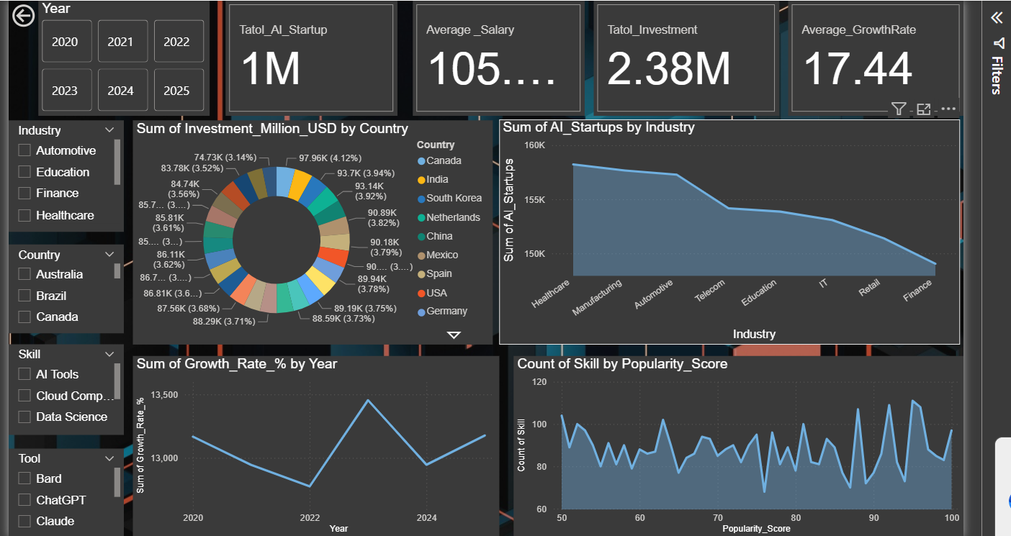
Notes:
Overview

Slide 13
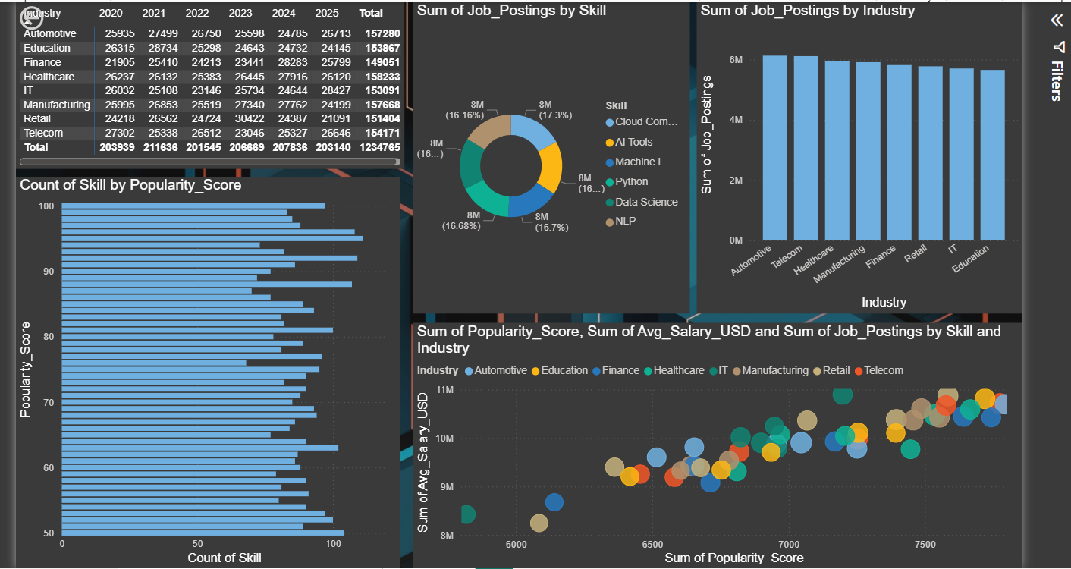
Notes:
Deep analysis

Slide 14
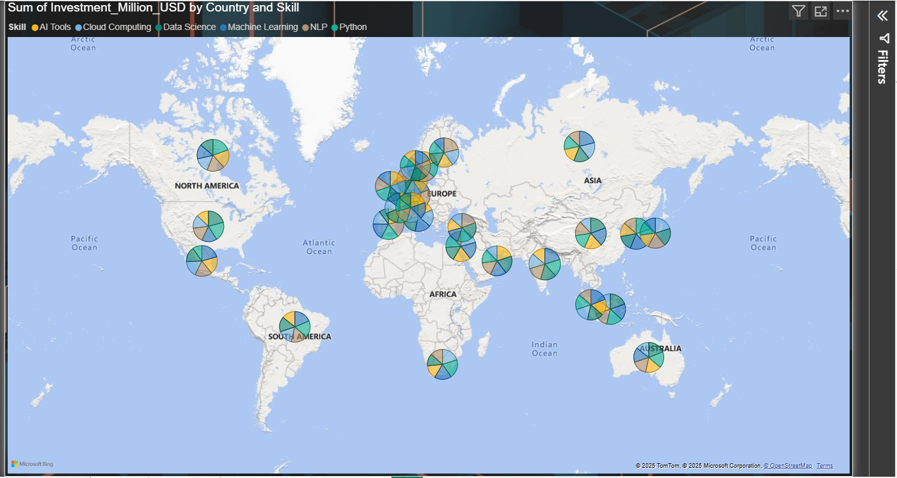
Notes:
Gobal map

Slide 15
Thanks you

